Slide 1

2021 Data Science Camp Artificial Neural Networks
Yuan Ke
The University of Georgia
July 15th, 9:00 – 13:00
Zoom link: https://zoom.us/j/91028661059

Slide 2

Outline
In the first part of today’s camp, we will learn the following topics
Applications of neural networks
Neuron
Architecture of neural networks
Learning with gradient descent
Design of hidden layers
Cost function
Learning with gradient descent
Example

Slide 3

Artificial Neural Networks
Artificial neural networks, also often called, deep neural networks or multilayer perceptrons (MLPs), are the quintessential deep learning models.
Receive (input) incoming information with dendrites
Process that information in the cell body
If activated, send (output) a signal with the axon
By BruceBlaus - Own work, CC BY 3.0, https://commons.wikimedia.org/w/index.php?curid=28761830

Slide 4


Artificial Neural Networks Today
AI Driving Cars
Self-driving vehicles are often powered by neural networks
Used to recognize objects on the road and to make decisions
Link to video: https://www.youtube.com/watch?v=B8R148hFxPw

Slide 5
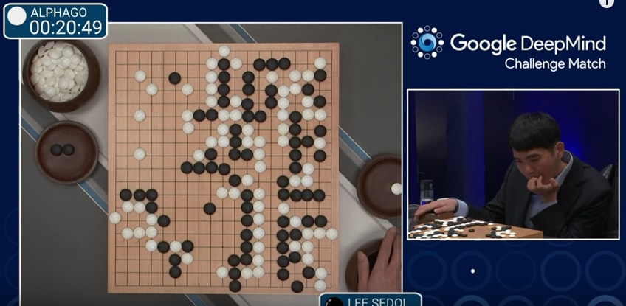
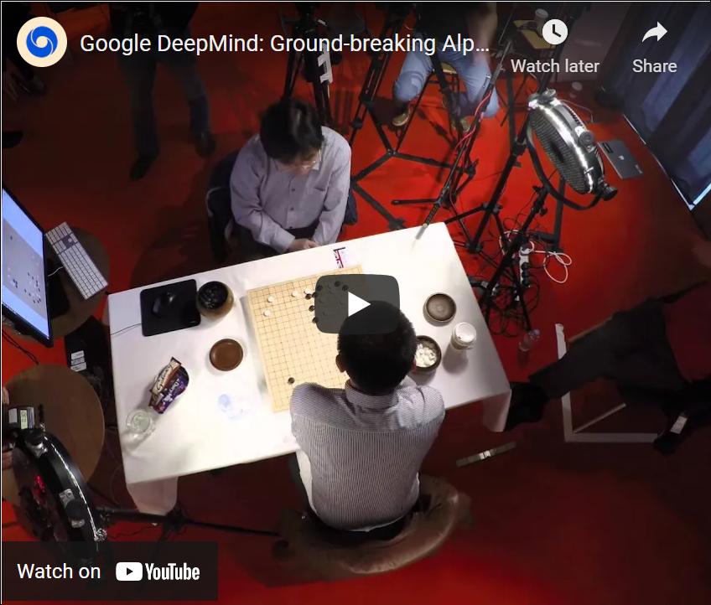
Artificial Neural Networks Today
AI Playing Go
Over a googol times as many board states as chess
Intuitive play
DeepMind defeated first ranked player Ke Jie in May 2017
Link to video: https://www.youtube.com/watch?v=SUbqykXVx0A

Slide 6
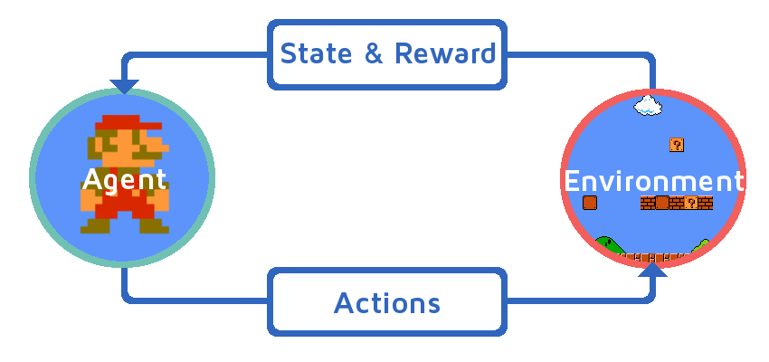

Artificial Neural Networks Today
Reinforcement learning
Goal-oriented algorithms, which learn how to attain a complex objective (goal) or maximize along a particular dimension over many steps; for example, maximize the points won in a game over many moves.
Link to video: https://www.youtube.com/watch?v=qv6UVOQ0F44

Slide 7
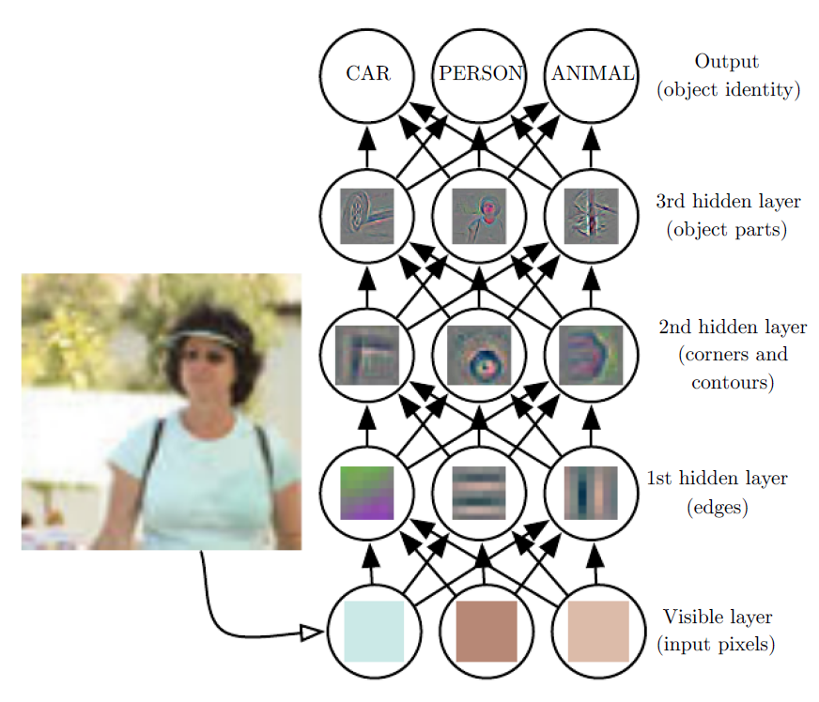
Example: Image Classification
Here is a toy example to illustrate the application of deep neural network on image classification.
The inputs are some images, and the output is a class label of the major object in the image.
The “circle” and “arrow” plot is called computational graph which is used to demonstrate the architecture of neural network.
Each circle indicates a neuron which is the basic unit in neural network. The arrows show the flow of information in the network.

Slide 8
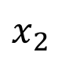
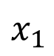
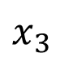
Artificial Neuron
Neuron is the basic unit of a neural network. It collects the information from multiple inputs and produce an output.
A way you can think about the neuron is that it's a device that makes decisions by weighing up evidence.
$$x_{1}$$
$$x_{2}$$
Neuron
Output
$$x_{3}$$
In the computational graph the neurons look like they have multiple outputs. In fact, they're still single output. The multiple output arrows are merely a useful way of indicating that the output from a neuron is being used as the input to several other neurons.

Slide 9
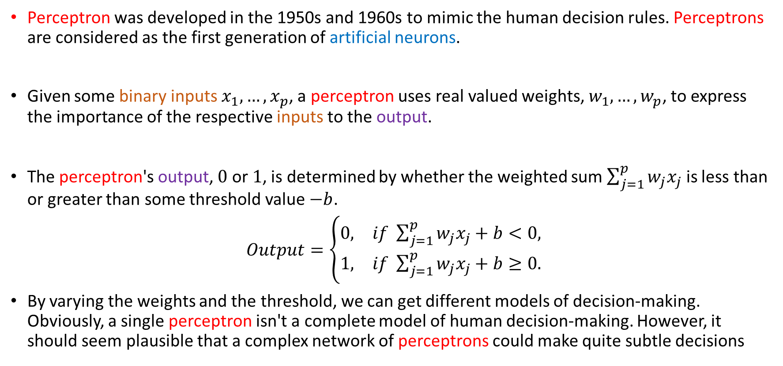
Perceptron
Perceptron was developed in the 1950s and 1960s to mimic the human decision rules. Perceptrons are considered as the first generation of artificial neurons.
Given some binary inputs $x_{1},…,x_{p}$, a perceptron uses real valued weights, $w_{1},…,w_{p}$, to express the importance of the respective inputs to the output.
The perceptron's output, $0$ or $1$, is determined by whether the weighted sum $\sum_{j=1}^{p}{w_{j}x_{j}}$ is less than or greater than some threshold value $−b$.
$Output=\left\{\begin{matrix}0, & if \sum_{j=1}^{p}{w_{j}x_{j}+b}<0, \\ 1, & if \sum_{j=1}^{p}{w_{j}x_{j}}+b≥0.\end{matrix}\right.$
By varying the weights and the threshold, we can get different models of decision-making. Obviously, a single perceptron isn't a complete model of human decision-making. However, it should seem plausible that a complex network of perceptrons could make quite subtle decisions

Slide 10
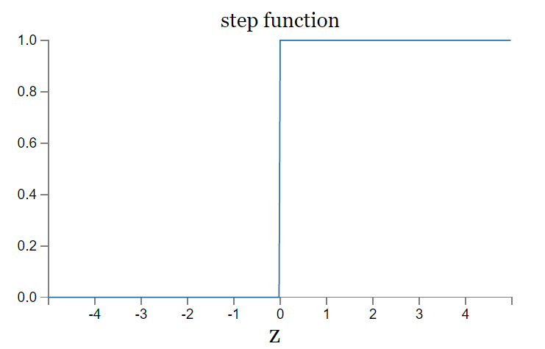
Issues of Perceptron
Though intuitive, perceptron has some issues in practice. Today, it's more common to use other models of artificial neurons, like sigmoid neurons.
Perceptron can only take binary inputs and produce binary outputs. It is not suitable for the variables with more than two options or even continuous.
Perceptron is equivalent to a step/indicator function and hence is sensitive to small changes close to the threshold value.

Slide 11
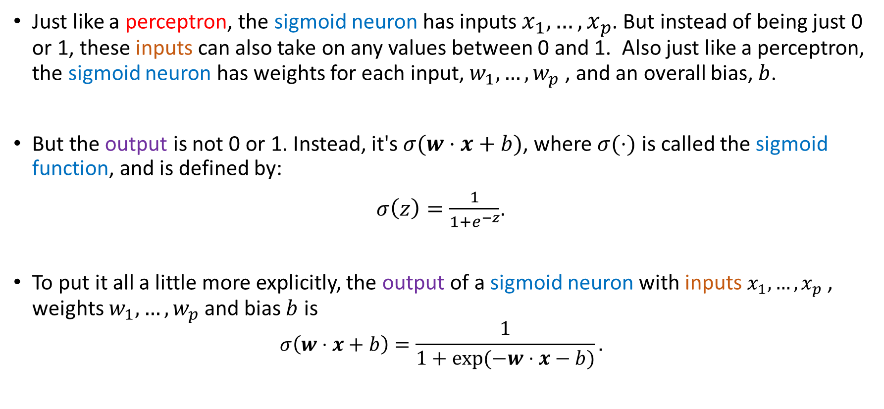
Sigmoid Neuron
Just like a perceptron, the sigmoid neuron has inputs $x_{1},…,x_{p}$. But instead of being just 0 or 1, these inputs can also take on any values between 0 and 1. Also just like a perceptron, the sigmoid neuron has weights for each input, $w_{1},…,w_{p}$, and an overall bias, $b$.
But the output is not 0 or 1. Instead, it's $σ(w⋅x+b)$, where $σ(⋅)$ is called the sigmoid function, and is defined by:
$σ\left(z\right)=\frac{1}{1+e^{−z}}$.
To put it all a little more explicitly, the output of a sigmoid neuron with inputs $x_{1},…,x_{p}$, weights $w_{1},…,w_{p}$and bias $b$ is
$$σ\left(w⋅x+b\right)=\frac{1}{1+exp⁡(−w⋅x−b)}.$$

Slide 12
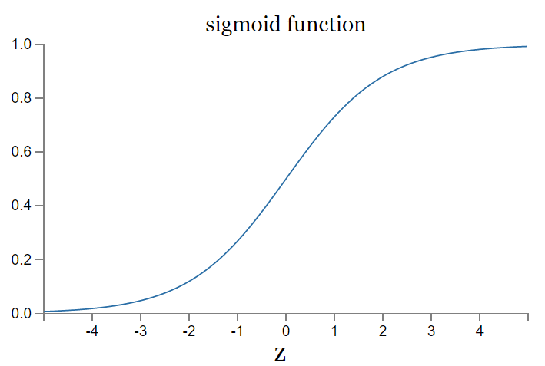
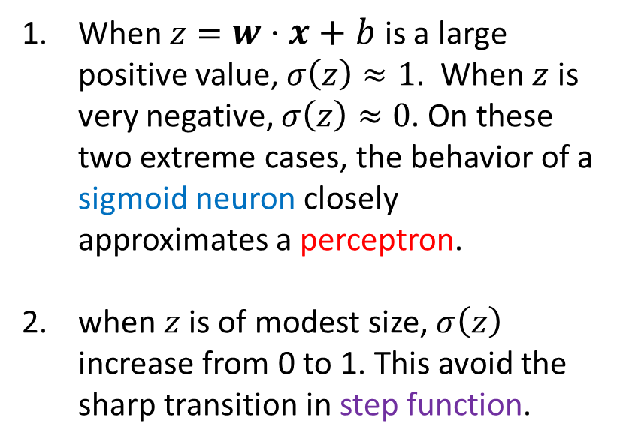
Sigmoid Function
At the first sight, sigmoid neurons appear very different to perceptrons. In fact, there are many similarities between perceptrons and sigmoid neurons.
When $z=w⋅x+b$ is a large positive value, $σ\left(z\right)≈1$. When $z$ is very negative, $σ\left(z\right)≈0$. On these two extreme cases, the behavior of a sigmoid neuron closely approximates a perceptron.
when $z$ is of modest size, $σ\left(z\right)$ increase from 0 to 1. This avoid the sharp transition in step function.

Slide 13
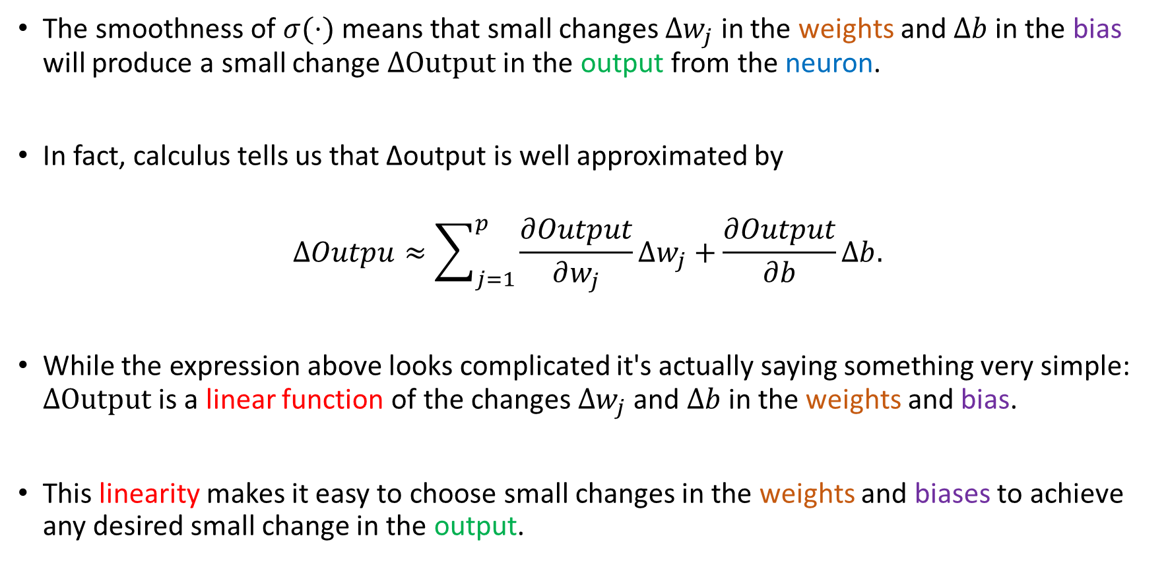
Property of Sigmoid Function
The smoothness of $σ(⋅)$ means that small changes $Δw_{j}$ in the weights and $Δb$ in the bias will produce a small change $ΔOutput$ in the output from the neuron.
In fact, calculus tells us that Δoutput is well approximated by
$$ΔOutpu≈\sum_{j=1}^{p}{\frac{∂Output}{∂w_{j}}}Δw_{j}+\frac{∂Output}{∂b}Δb.$$
While the expression above looks complicated it's actually saying something very simple: $ΔOutput$ is a linear function of the changes $Δw_{j}$ and $Δb$ in the weights and bias.
This linearity makes it easy to choose small changes in the weights and biases to achieve any desired small change in the output.

Slide 14
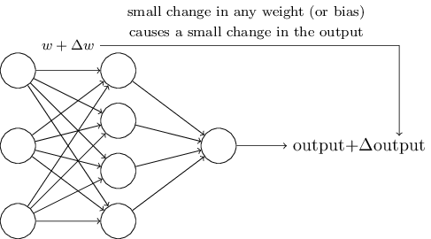
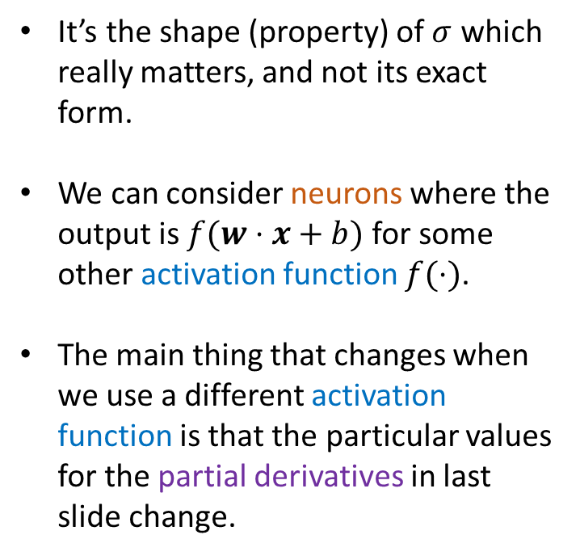
Property of Sigmoid Function (cont.)
Though sigmoid neurons have much of the same qualitative behavior as perceptrons, they make it much easier to figure out how changing the weights and biases will change the output.
It’s the shape (property) of $σ$ which really matters, and not its exact form.
We can consider neurons where the output is $f(w⋅x+b)$ for some other activation function $f(⋅)$.
The main thing that changes when we use a different activation function is that the particular values for the partial derivatives in last slide change.

Slide 15
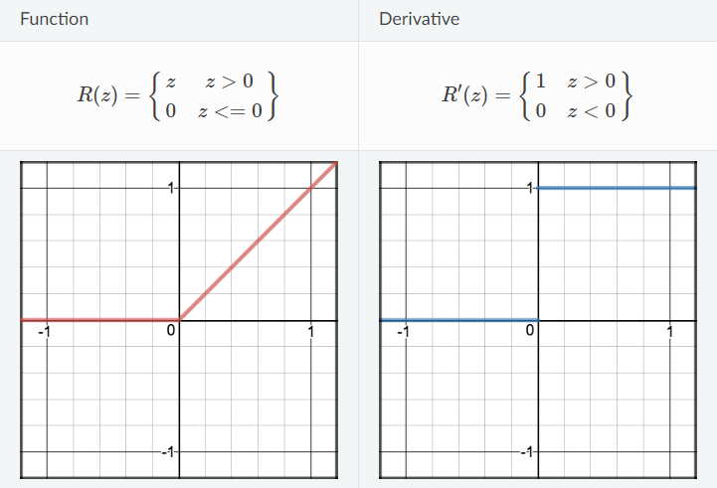
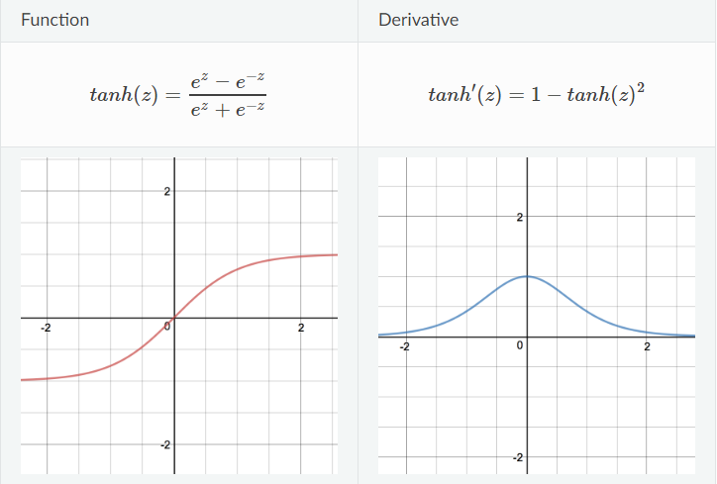
Some Activation Functions
Rectified Linear Units (ReLu)
Hyperbolic tangent function (Tanh)
Easy to compute. Non vanishing gradient for large $z$.
Stronger gradient than Sigmoid.

Slide 16
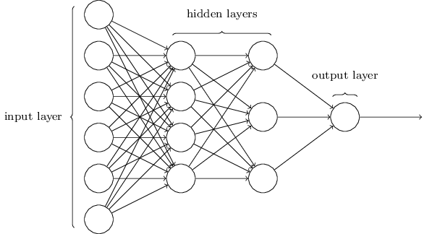
Connect Neurons to a Neural Network
The way to connect neurons also played an important role in defining a neural network. In general, we can use a “circle” plus “arrow’ plot to show the architecture of neural networks. The arrows show the direction of information flow.
As mentioned earlier, the leftmost layer in this network is called the input layer, and the neurons within the layer are called input neurons.
The rightmost or output layer contains the output neurons, or, as in this case, a single output neuron.
The middle layer is called a hidden layer, since the neurons in this layer are neither inputs nor outputs. In this example, the network has two hidden layers

Slide 17
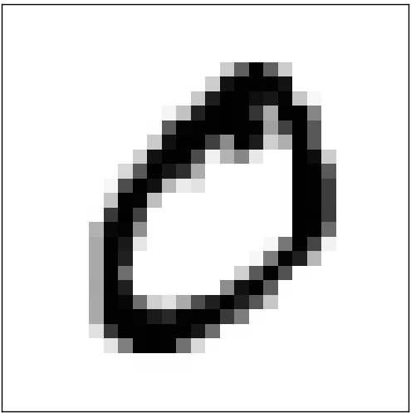
Design of Input and Output Layers
The design of the input and output layers in a network is often straightforward.
Suppose that we want to learn the digit in a handwritten image is “0” or not.
A natural way to design the network is to encode the intensities of the image pixels into the input neurons. If the image is a 28 by 28 greyscale image, then we'd have 784=28×28 input neurons, with the intensities scaled appropriately between 0 and 1.
The output layer will contain just a single neuron, with output values of less than 0.5 indicating "input image is not a 0", and values greater than 0.5 indicating "input image is a 0 ".

Slide 18
Design of Hidden Layers
While the design of the input and output layers of a neural network is often straightforward, there can be quite an art to the design of the hidden layers.
For a feedforward neural network, we usually need to consider the following aspects when designing hidden layers:
Activation function
Number of hidden layers
Number of neurons in each hidden layer
Connectivity of hidden layers
In practice, it's not possible to sum up the design process for the hidden layers with a few simple rules of thumb. Optimal choice is very data, problem and experience dependent.

Slide 19
Design of Hidden Layers
While the design of the input and output layers of a neural network is often straightforward, there can be quite an art to the design of the hidden layers.
For a feedforward neural network, we usually need to consider the following aspects when designing hidden layers:
Activation function
Number of hidden layers
Number of neurons in each hidden layer
Connectivity of hidden layers
In practice, it's not possible to sum up the design process for the hidden layers with a few simple rules of thumb. Optimal choice is very data, problem and experience dependent.

Slide 20
Architecture of Feedforward Neural Network
Suppose that we want to learn $y^{∗} = f^{∗}(x)$ through a $J$ layers feedforward neural network. We summarize its architecture as follows:
Input Layer: $h^{(1)}=g^{\left(1\right)}(w^{\left(1\right)}⋅x+b^{(1)})$,
First Hidden Layer: $h^{(2)}=g^{\left(2\right)}(w^{\left(2\right)}⋅h^{(1)}+b^{(2)})$,
Second Hidden Layer: $h^{(3)}=g^{\left(3\right)}(w^{\left(3\right)}⋅h^{(2)}+b^{(3)})$,
⁞
Final Hidden Layer: $h^{(J−1)}=g^{\left(J−1\right)}(w^{\left(J−1\right)}⋅h^{(J−2)}+b^{(J−1)})$,
Output Layer: $\hat{y}=g^{\left(J\right)}(w^{\left(J\right)}⋅h^{(J−1)}+b^{(J)})$.
In these chain-based architectures, the main architectural considerations are to choose the depth of the network and the width of each layer.

Slide 21
Cost Function
In order to approximate the unknown function $y^{∗}=f^{∗}(x)$ for all training inputs $x$, we need to choose weights and biases in each layer.
Our goal in training a neural network is to find weights and biases which minimize a cost function $C\left(w^{(1)}, …,w^{(J)};b^{(1)},…,b^{(J)}\right)$.
To quantify how well we're achieving this goal, we can define a quadratic cost function,
$$C\left(w^{(1)}, …,w^{(J)};b^{(1)},…,b^{(J)}\right)=\sum_{x}{{\left\|\hat{y}\left(x\right)−y^{∗}\left(x\right)\right\|}^{2}},$$
where $\hat{y}\left(x\right)$ is the output from neural network with input $x$.
The reason for considering the quadratic cost function is due to its smoothness and computational simplicity.

Slide 22
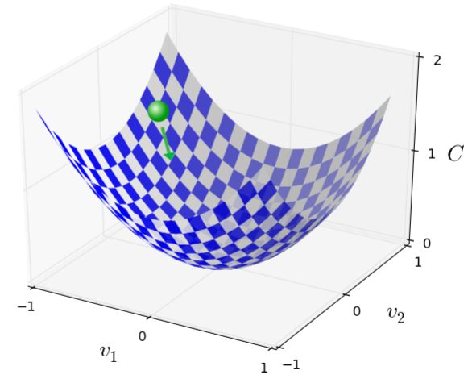
Minimizing Cost Function
In order to minimize the cost function $C\left(w^{(1)}, …,w^{(J)};b^{(1)},…,b^{(J)}\right)$, we approximate a small change of $C$ as follows:
$$ΔC≈\frac{∂C}{∂w^{\left(1\right)}}Δw^{\left(1\right)}+⋯+\frac{∂C}{∂w^{\left(J\right)}}Δw^{\left(J\right)}+\frac{∂C}{∂b^{\left(1\right)}}Δb^{\left(1\right)}+⋯+\frac{∂C}{∂b^{\left(J\right)}}Δb^{\left(J\right)}.$$
Let’s imagine the minimization process through a two-dimensional toy example.
Suppose a ball starts at somewhere in this net and wants to reach the global minimum.
We're going to choose a direction, so the ball is rolling down into the valley, i.e. choosing $ΔV$ so as to make $ΔC$ negative.

Slide 23
Learning with Gradient Descent
Denote $ΔV=(Δw^{\left(1\right)},…,Δb^{\left(J\right)})′$ and $∇C=(\frac{∂C}{∂w^{\left(1\right)}}, …,\frac{∂C}{∂b^{\left(J\right)}})′$ the gradient of $C$, the small change of $C$ is approximated by the inner product:
$$ΔC≈∇C⋅ΔV.$$
To make sure $ΔC$ is negative, we can choose $ΔV$ on the opposite direction of the gradient $∇C$, i.e.
$ΔV=−η∇C$,
where $η$ is some positive parameter.
Then we have $ΔC≈∇C⋅ΔV=−η∇C⋅∇C=−η{\left\|∇C\right\|}^{2}≤0$.
This motiviates us to update $V=(w^{(1)},…,b^{(1)})$ along the opposite direction of the gradient of $C$ at $V$ until convergence.
$$V^{(k+1)}=V^{(k)}−η∇C(V^{(k)}).$$

Slide 24
Back-Propagation
Though the idea of gradient descent is straightforward, the calculation of gradients can be non-trivial given the complicated and recursive network structure.
The back-propagation algorithm (Rumelhart et al., 1986), often simply called backprop, allows the information from the cost to flow backwards through the network, in order to compute the gradient.
The back-propagation algorithm utilizes the chain rule of calculus to efficiently calculate the partial derivatives.
Suppose that $y=g(h)$ and $h=f(w)$, with $x∈ℝ^{p}$ and $h∈ℝ^{q}$, then the gradient of $y$ with respect to $w_{i}$ is
$\frac{∂y}{∂w_{i}}=\sum_{j}{\frac{∂y}{∂h_{j}}\frac{∂h_{j} }{∂w_{i}}},$ or in vector notation $∇_{w}y=\left(\frac{∂h}{∂w}\right)′∇_{h}y$,
where $\frac{∂h}{∂w}$ is the $q×p$ Jacobian matrix of $f$.

Slide 25
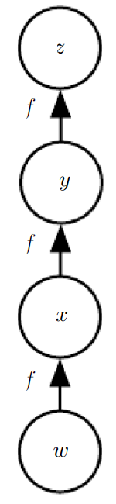
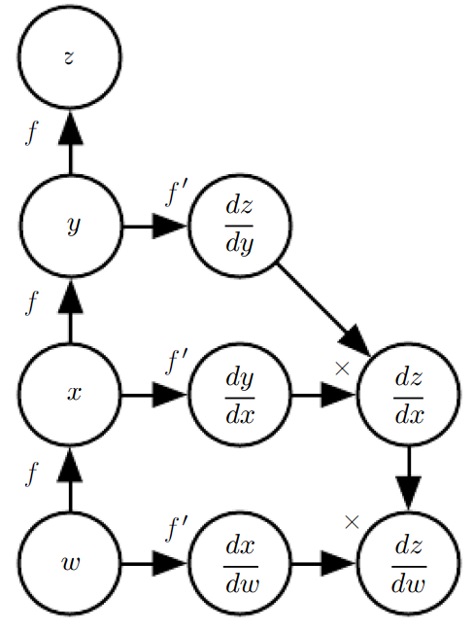
Computational Graph
The idea of feedforward network and backward-propagation can be demonstrated through computational graphs with symbolic operators.
Feedforward
Back-prop

Slide 26
Neural Networks with TensorFlow and Keras

Slide 27


Neural Networks with TensorFlow and Keras
ANNs require a lot of rather simple calculations…exactly the sort of thing computers are good at!
TensorFlow (TF) and Keras is a framework that provides a relatively easy way to create and train ANNs.
Used to be separate projects, but have been merged
This is not the “only game in town, but it is the framework for this module.”
Documentation: https://www.tensorflow.org/

Slide 28




Working With TF/Keras
Primary objects: models and layers
Model objects come in two types:
Sequential models: easier to build, but more restricted network structure (we will use these!)
Functional API models: much more freedom in model architecture, but with freedom comes responsibility
Once a model is created, layers are added
Layers produce a collection of nodes that are collected together
All nodes receive the same input (previous layer) and transmit output to the same place (next layer)
Node properties (e.g., activation functions) are set at the layer level, and consistent for all nodes on a given layer.
$$x_{1}$$
$$x_{2}$$
$$Y$$
$$x_{3}$$
Output layer
Input layer
Hidden layer 1
Hidden layer 2

Slide 29
Basic TF/Keras Model Fitting Procedure
(1)
(2)
(3)
Load and prepare your data
In “real life,” this always takes the most time!
Create a model object using Sequential().
Add the layers you desire. Specify layer properties as you go. We will use Dense() layers.
(4)
(5)
(6)
(7)
Add an output layer.
Remember that the dimension should match that of the response, and the activation function should match.
Again, use Dense().
Compile your model.
Specify the loss function and optimizer.
Fit your model to data.
Various options are available.
Examine the training curve and evaluate model performance.
Adjust your model and repeat as necessary.
(8)
Notes:
A Sequential model is appropriate for a plain stack of layers where each layer has exactly one input tensor and one output tensor.
Dense layer is the regular deeply connected neural network layer. It is most common and frequently used layer. Dense layer does the below operation on the input and return the output.

Slide 30
Overview of the TF/Keras Dense Layer Options
This is the number of neurons to include on that layer!
## Start with an empty model
model = Sequential()
## Add a hidden layer
model.add(Dense(30, input_dim=10 , activation='tanh'))
model.add(Dense(20, activation='tanh'))
## Add a hidden layer-- specify the dimension
model.add(Dense(1, activation='sigmoid')
The first layer needs to specify the number of predictors. Elsewhere, TF/Keras will figure this out for you!
Specify the activation function for the neurons on that layer.
Options: ‘sigmoid,’ ‘tanh,’ ‘linear,’ ‘relu,’ etc.
Remember that the output should match the response. Here, we have a binary response, so we use the sigmoid activation function.

Slide 31
TF/Keras Compile and Fit
Define an appropriate loss function for your response:
‘binary_crossentropy’ for binary ‘mean_squared_error’ for continuous
Choose an optimizer.
Good bets: ‘adam,’ ‘sgd’
## Compile the model
model.compile(optimizer='sgd', loss='binary_crossentropy', metrics=['acc'])
## Fit the model
hst = nn_new.fit(x, y, batch_size=50, epochs=250, verbose=0)
Nature of processing updates. Change to 1 for exciting updates!
The data: first predictors, then response
Batch Size: Number of observations to look at a time
Epochs: How many times to look at the entire data set.
Notes:
Adam : adaptive moment estimation
By setting verbose 0, 1 or 2 you just say how do you want to 'see' the training progress for each epoch.
verbose=0 will show you nothing (silent)
verbose=1 will show you an animated progress bar like this:
verbose=2 will just mention the number of epoch like this:

Slide 32
Flexibility of TF/Keras
Designed to be easy to use, but offers advanced users the flexibility they need.
Provides ways to customize:
Layers, including size and activation functions – we will see other layer types in upcoming modules!
Advanced network structures (convolutional, recurrent network structures)
Optimizers (training algorithms)
Other network features
Most of these offer easy-to-use features, right out of the box, but are also easy to customize of needed.

Slide 33
Practical Considerations When Working with Data

Slide 34
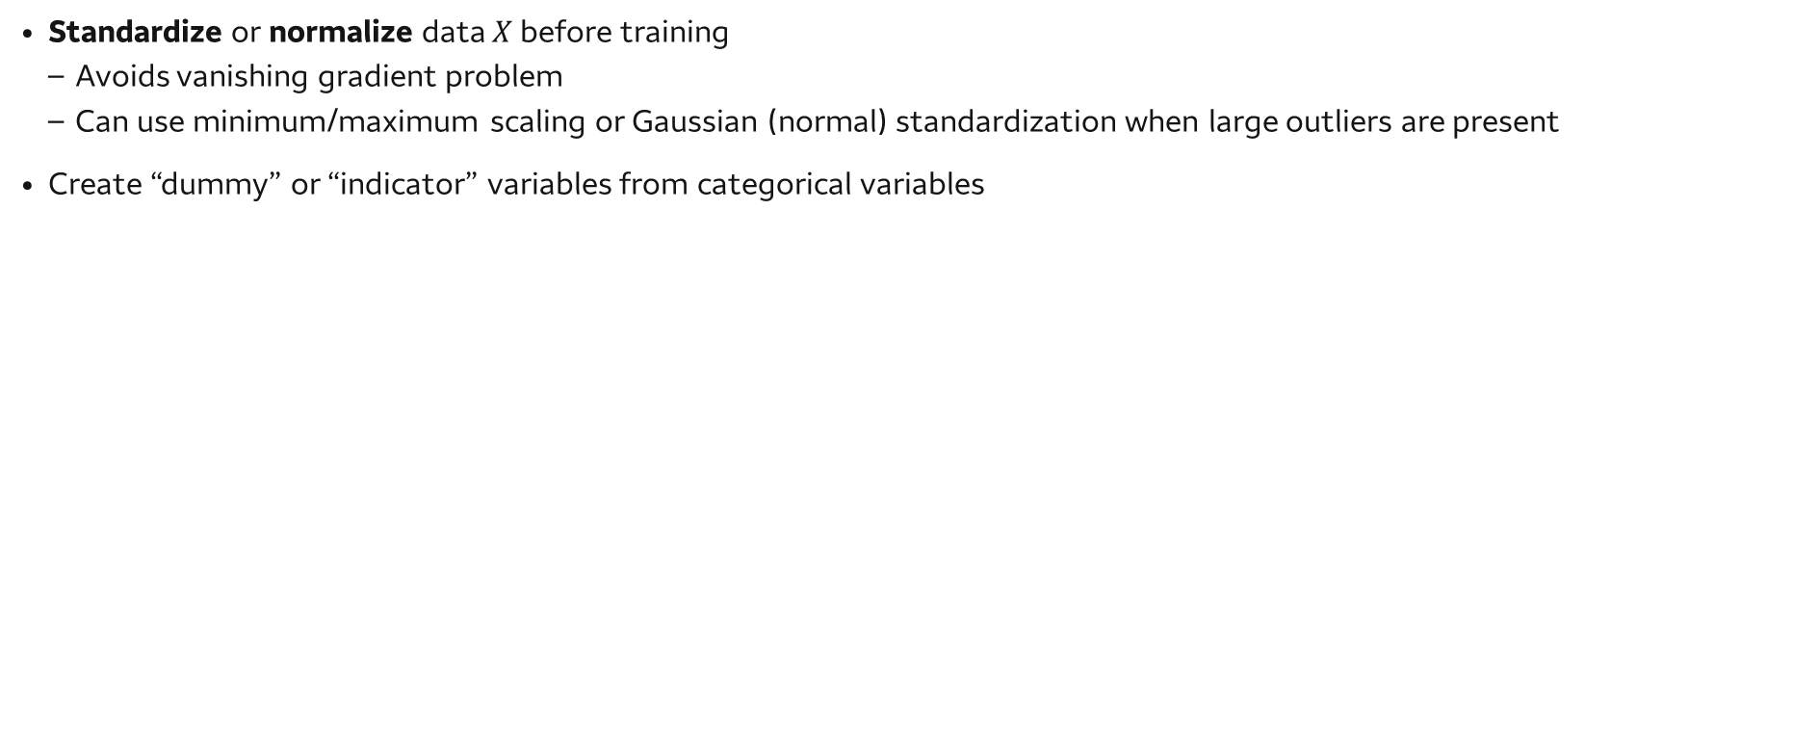
Data Preparation for Neural Networks
Standardize or normalize data $X$ before training
Avoids vanishing gradient problem
Can use minimum/maximum scaling or Gaussian (normal) standardization when large outliers are present
Create “dummy” or “indicator” variables from categorical variables

Slide 35
Choice to Make When Using Neural Networks
Network structure and properties
How many layers will you use?
How many nodes will be found in each layer?
Which activation function will we use?
Train the network effectively
Which training algorithm will we choose? (Consider using an algorithm with learning rate decay like Adam)
Which mini-batch size will we use (Smaller batches can be slower and more volatile, but can help escape local minima/saddle points)
How long will we train the network (number of epochs)?
Avoid overfitting!

Slide 36
Overfitting
Neural networks are flexible models, with a (potentially) large number of parameters – overfitting is a concern
Strategies to avoid overfitting in ANNs include:
Multiple narrow layers vs. single wide layer
Weight regularization: penalizing large weights in the cost function
Dropout: randomly set a fraction of neurons’ activations to 0 during training
Forces redundancy of neurons, and reduces neuron specialization
Early stopping via a validation data set

Slide 37
Time to build some networks!

Slide 38
Neural Networks Wrap-Up
Models discussed
Neural networks: single and multiple layers
Tools discussed
TensorFlow and Keras
Examples discussed
Object recognition
AI playing video games
AI driving cars

